Slide 1
Chapter 6 Transient flow to wells

Slide 2
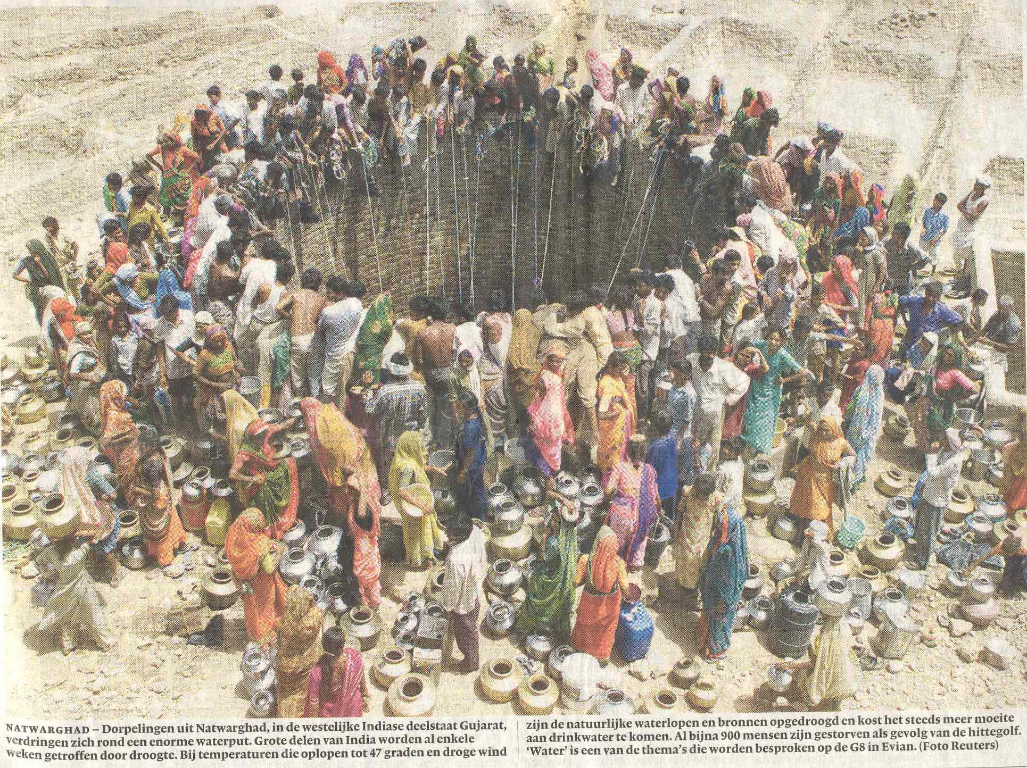

Slide 5
Overview of groundwater well solutions
Name | Water table? | Lekage? | Transient? | Solution
Thiem | Yes | no | no
Thiem | no | no | no
De Glee (1930) | no | yes | no
Theis (1935) | no | no | yes
Hantush (1955) | no | yes | yes

Slide 6
Governing partial differential equation (PDE)
Derive the PDE for the leaky Hantush case.
Show that Theis (no leakage) is a just special case.
The flow is transient and axially symmetric (with respect to the well).
The components to consider are
Flow in the aquifer
Vertical exchange through an aquitard with an adjacent layer having constant head
Storage.

Slide 7
arbitrary datum

Slide 8
Write the water budget for the ring in terms of flow rates: (In = our + storage)
Split the first term with
Divide all terms by
Let
Write and

Slide 9
Partial differential equations for the Hantush and the Theis case
With leakage (Hantush)
Water from storage and leakage
Without leakage (Theis)
Water only from storage
Theis’ is a special Hantush case for no leakage

Slide 10
Solutions for wells with constant extraction Q₀ for t>0
⟸ Boundary condition
⟸ Initial condition
⟸ Boundary condition
With leakage (Hantush)
Hantush’ well function
Without leakage (Theis)
Theis’ is a special Hantush case for no leakage
Theis’
well function

Slide 11
Linearizing the solutions for approximate use in water-table aquifers.
Q₀
s
S=S_{y}
k
h
H
r
with
transient →
with

Slide 12
Implementing Theis and Hantush well functions
We’ll use Python. Download the Anaconda individual edition (already 20 million people have done so).
For exercises see tutorials that Prof. Mark Bakker of TUDelft prepared for TUD students intro course called exploratory computing with Python.
We’ll start in class using Jupyter notebooks
What is a Jupyter notebook?
We’ll start practicing in class.

Slide 13
Exercise applying Theis
Compute and show the drawdown by for wells in a square with sides of L = 1 km
Task
First well starts at t=0 d
Second wel at t = 365 d
Third well at t = 730 d
Fourth well at 1095 d
kD = 600 m2/d
Sy = 0.24
Q = 14400 m3/d
Compute and show the drawdown in the center of the square as a function of time up to t=10 years.
Compute and show the drawdown on a grid as contour lines

Slide 14
Well1 (14400 m³/d from t=0)
Well2 (14400 m³/d from t=365 d)
1000 m
Well4 (14400 m³/d from t=1095 d)
Well3 (14400 m³/d from t=730 d)
1000 m

Slide 15
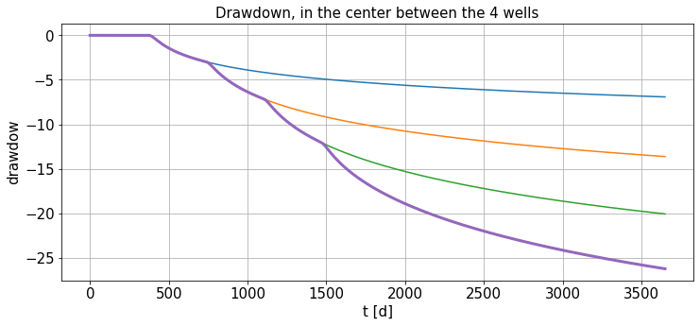
Drawdown in the center of the square over time

Slide 16
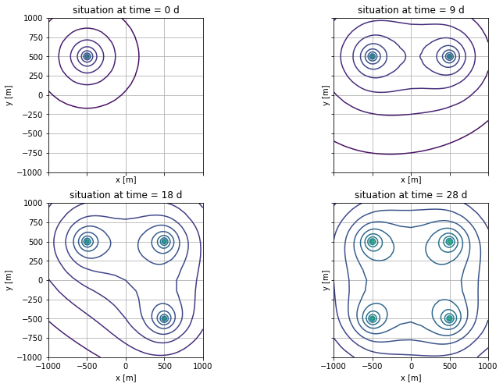
Drawdown contours

Slide 17
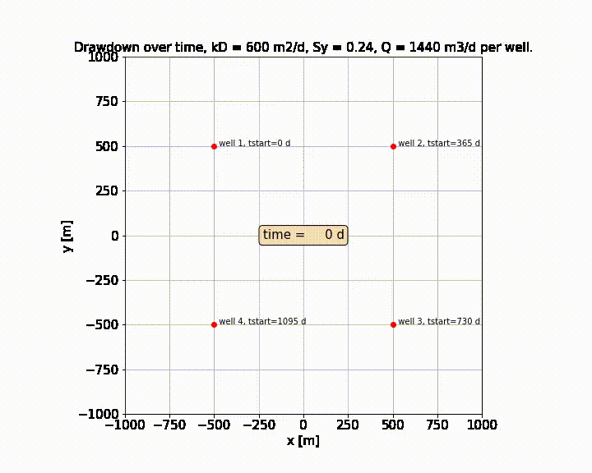

Slide 18
Exercise, compare Theis and Hantush with multiple wells
Consider 5 wells 80 m apart start extracting Q=240 m3/d each at t=0
Aquifer: kD = 600 m²/d, Sy = 0.22, c= 200 d
Show the head development a long the x-axis
For the Theis situation (c = inifnite)
For the Hantush situaiton (c = 200 d)
320 m
x-axis
Compare the development over time both the
Theis and the Hantush situations.

Slide 19
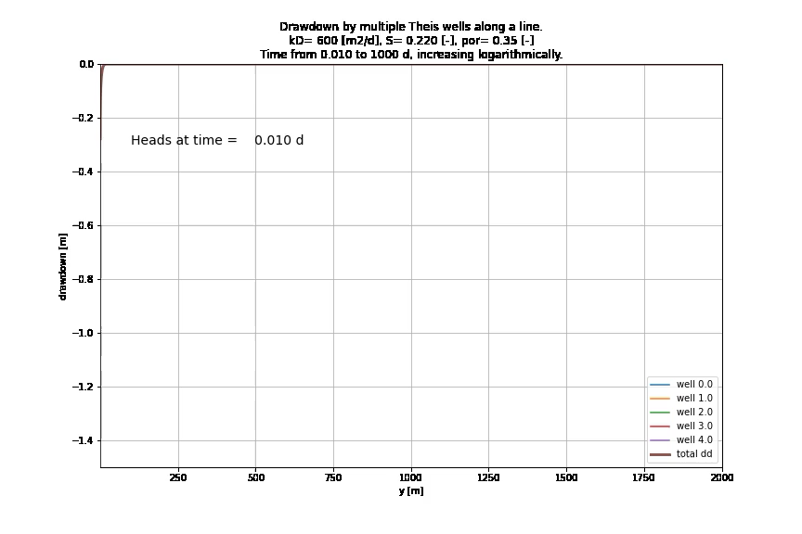
Animation may not be visible in pdf, see original powerpoint

Slide 20
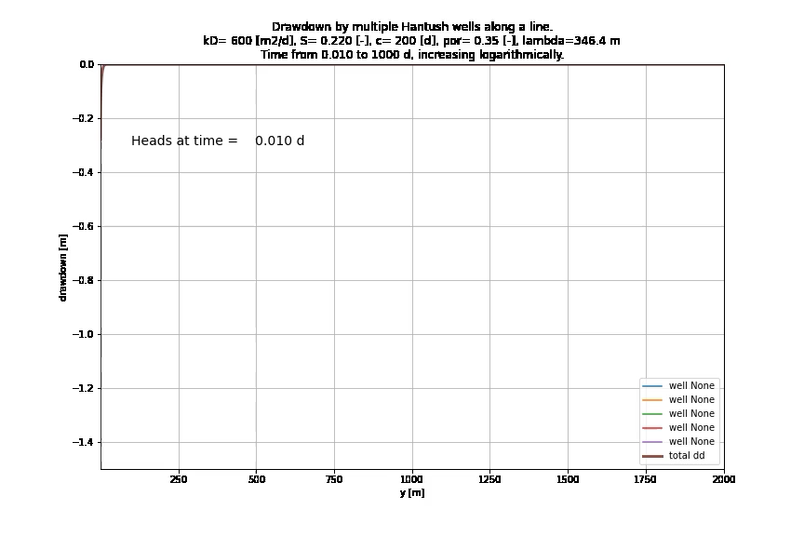
Animation may not be visible in pdf, see original powerpoint

Slide 21
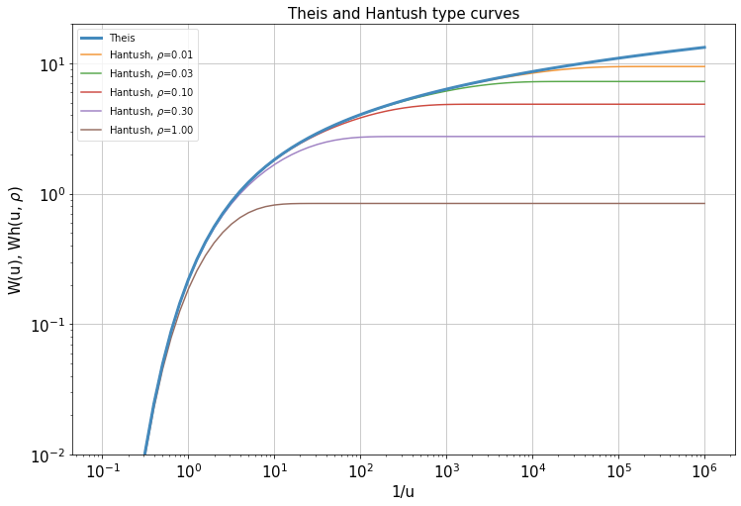
Type curves for the Theis and Hantush Well functions (double log axes)
Theis
Notice the use of 1/u

Slide 22
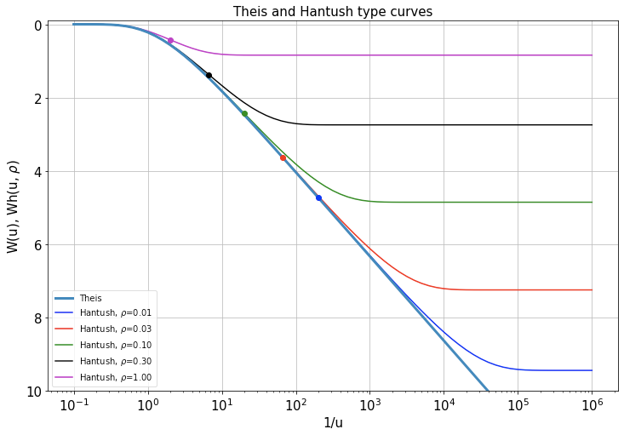
Type curves for the Theis and Hantush Well, halflog 1/u axis
Inflection points
Inflection points
Inflection points
Theis → straight line
Theis

Slide 23
Theis well-function series expansion and its approximation
= so-called Euler constant
Approximation for u < 0.1

Slide 24
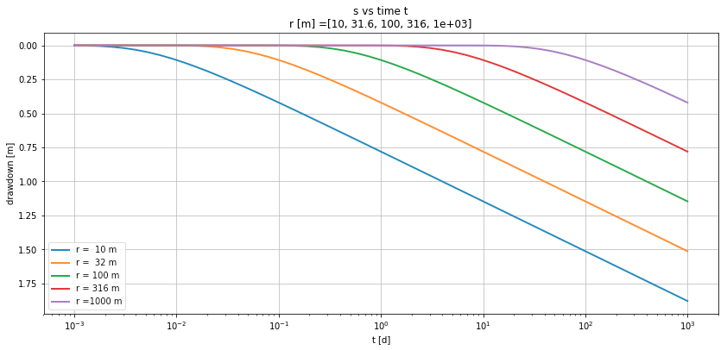
Exact vs approximate Theis solution
Approximate Theis
exact Theis
At larger distance, the drawdown starts later but follows the same line when plotted versus log(t)

Slide 25
Radius of influence
How far does the drawdown reach at any point in time?
As a simple approximation set s = 0 in the approximation of the Theis drawdown.
This is the case when the argument of the logarithm equals 1

Slide 26
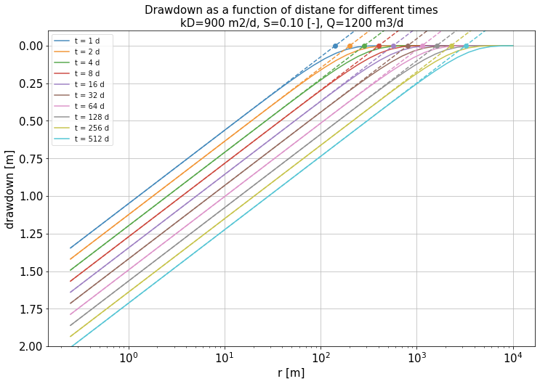
Visualizing the radius of influcence
Radius of influence
(dots)
Theis drawdown approximation
(dashed lines)
Theis drawdown at various times

Slide 27
Flow (discharge) Q_{r} in the aquifer at a distance r from the Theis well extracting Q_{o}

Slide 28
Flow (discharge) Q_{r} in the aquifer at a distance r from the Theis well extracting Q_{o} (continued)

Slide 29
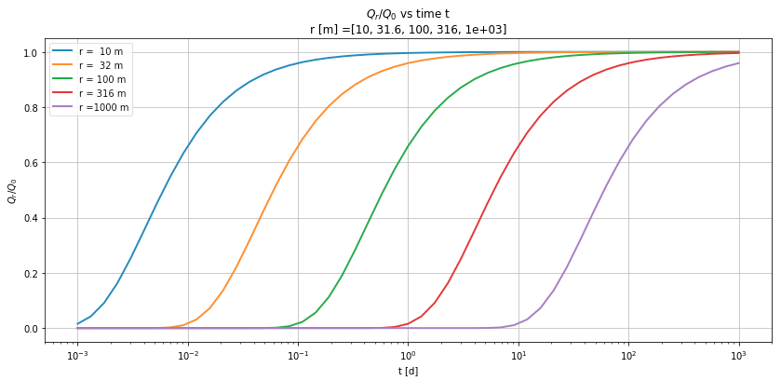
Visualizing the relative discharge Q_{r} /Q₀ in the aquifer at a distance r from the Theis

Slide 30
What does the decline of the ratio Q_{r}/Q₀ with time mean?
At any distance, Q_{r}→Q₀ with time the discharge at any distance r will approach that of the well.
Although the drawdown will never become constant in the Theis case, the gradients will, because the discharge will become constant at any r
Interpreting a transient pumping test may be done using the stationary Thiem solution but not based on the absolute heads but on the head differences between observation wells at different distances from the well.
All water comes from storage in the Theis case, but it will come from larger distances as time with time.
The approach Q_{r} → Q_{o} is the cause of the existance of a radius of influence that grows with time.
Because of the same reason, the dawdown with log of distance must form a straight line for all distances up to about the radius of influence (can you proof this argument?)
In fact, the radius of influence has the same role as the boundary radius with zero drawdown in the steady case. Only, in the transient Theis case, this radius increases with the root of time.

Slide 31
Pumping tests
A pumping trest on a well is done to obtain aquifer parameters needed in groundwater calculations.
Piezometer wells are (generally) installed at different distances of the well. Groundwater levels are registered by hand an or by loggers.
The well pump is started as some moment, using a pump with a virtually constant discharge.
Groundwater levels are registered with high frequency at first, possibly reducing the frequence at later times.
Pumping is continued for as long as desired giving the expected time required to collect adequate data, taking into consideration the pumping and labor cost and the permit issued by the regulator.
After stopping the pump, registration is continued at high frequency to monitor the rapid restoration of the groundwater levels, which is called the stop-test. The stop test has guaranteed constant flow, as it is zero.
Finally, the data are assembled and interpreted by a hydrologist. This is often done with a computer model or specific pumping-terst software. However, before using such software in a final step, the data have to be explored, which is done on the classical way to get the required insight.

Slide 32
Consider a pumping test in the situation shown in the following slide
A well with a partially penetrating screen installed in an aquifer 60 m thick.
12 observation wells were installed, 6 at 10 m above the bottom of the aquifer and 6 at 50 m above the bottom of the aquifer.
The distances are 0.25, 10, 30, 60, 120 and 240 m
The well extracts a constant flow of Q=2400 m3/d
The drawdown data are given
Determine the transmissivty, storage coefficient and and possibly the vertical hydraulic resistance of the overlying aquitard

Slide 34
Pumping test in a Theis situation (confined aquifer)
The data shown also reveal some noise, which is normal given weather and barometer fluctuations.
On logarithmic time axis (second chart) we see that the drawdown follows straight lines in all piezometers and that these lines are all parallel. This shows that we have a Theis situation here. No leakage. The straight line fulfills
To determine the transmissivity we only need the drawdown per log-cycle of time. That is have the the drawdown at time 10t minus that at time t for any t. Due to which the logarithm becomes a constant.

Slide 35
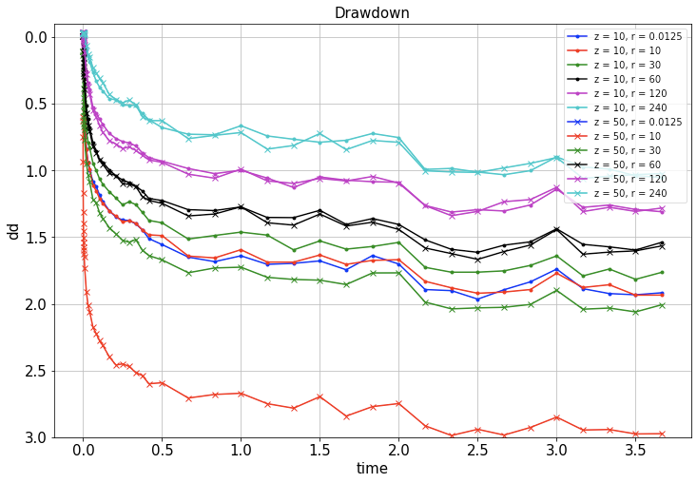

Slide 36
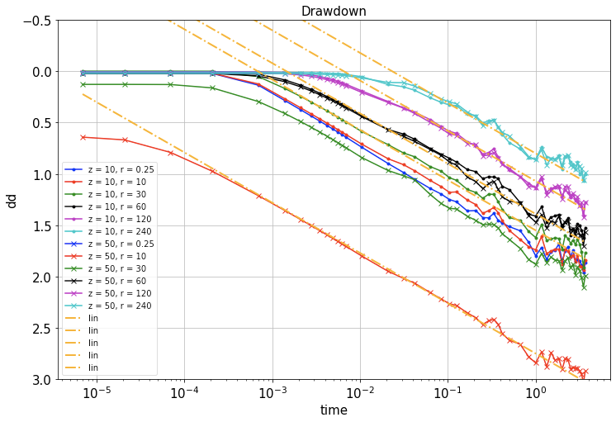

Slide 37
Further step drawdown versus t/r²
When the drawdown is plotted versus t/r² instead of t, all the drawdown lines should collapse to a single line (except for those piezometers that have extra drawdown caused by partial penetration)
Hence, the blue (r=0.25 m), red (r = 10 m) and green (r = 30 m) lines suffer from partial penetration. The lines over 60 m from the well do not. For these distances, the data from the upper and the lower piezometer coincide.
To determine the storage coefficient, we can use the simplified Theis logarithmic approximation and set it equal to zero (argument of the logarithm equal to 1). But this is only valid for the piezometers without an effect of partial penetration. Otherwise the intersection of the straight portion of the drawdown with zero drawdown is wrong.
With the transmissivity already known from the dawdown per log cycle, we now also have the storage coefficient, which concludes the interpretation of this pumping test.

Slide 38
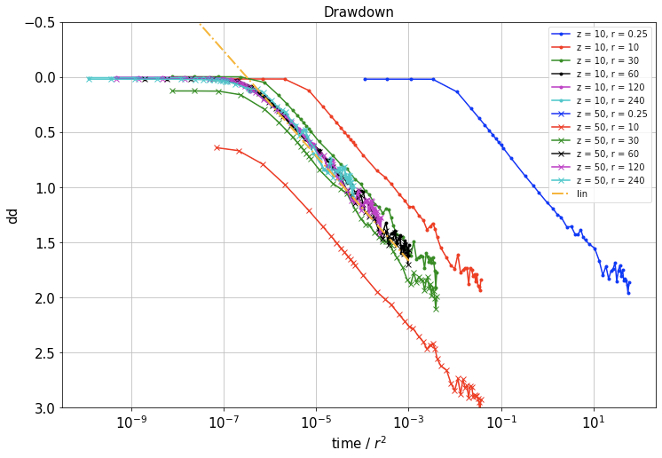

Slide 39
Pumping test in a semi-confined aquifer (Hantush case)
Data on next page show that after some time, the decline of the heads stops, so equilibrium developes, hence this is a Hantush case.
The straight portion of the drawdown of different piezometers is not long the same (see dashed lines). So the simple Theis approximation is no longer applicable.
We do a classic analysis with the data on double log axes.

Slide 40
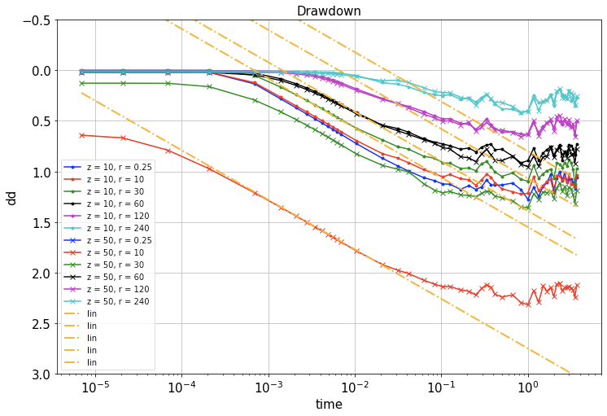

Slide 41
Classic analysis
Puts the data in a chart with double log axes.
Second chart: rather not versus log t but versus log t/r² so that all curves that do not suffer from partial penetration fall on a single curve.
Third chart. We have to leave out all curves of piezometers closer than 60 m, due to partial penetration. And we ignore the small drawdowns, because they suffer from measurement inaccuracy and noise.

Slide 42
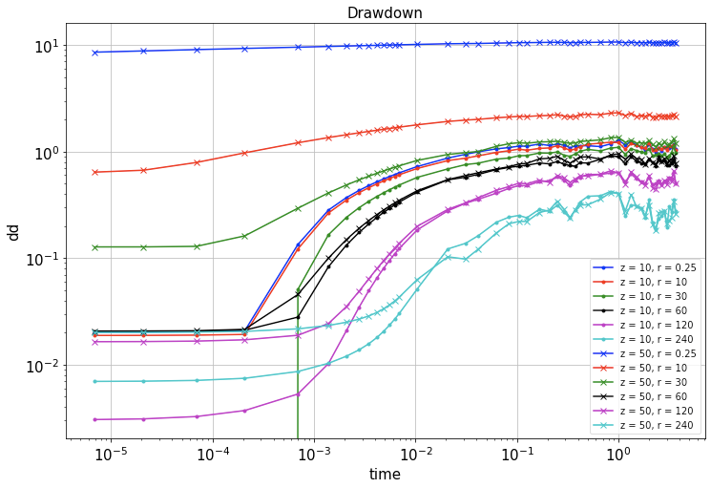

Slide 43
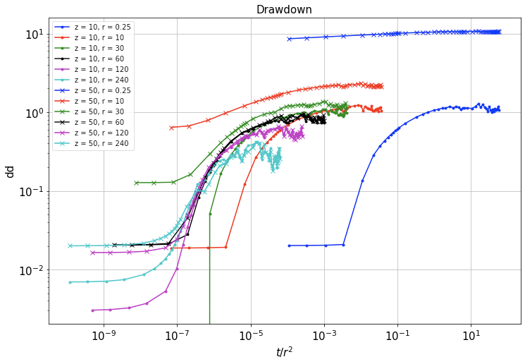

Slide 44
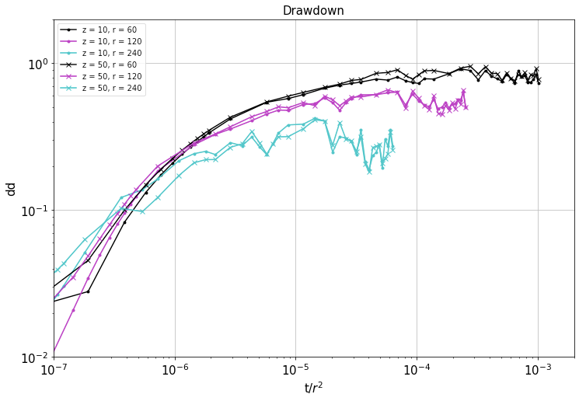

Slide 45
Classic analysis continued
Make a chart with the Hantush type curves (W(u, r/𝜆) versus 1/u), also on double log axes, such that the width of log cycles is the same as that of the chart with the data (s_{r,t} versus t/r²) are the same.
Doing this, the measured drawdowns should have the exact same shape as the type curves (why?)
Shift the sheet with the type curves over that of the data until both fit as well as possible.
Choose one arbitrary point (the match point), i.e. hammer a pint through both sheets. (Thick dot on the next chart)
Then note down the corrsponding drawdown s and t/r² of the match point on the data chart and the corresponding W(u) and 1/u of the mathc point on the chart with the type curves.
From these corresponding points compute the transmissivity kD and the storage coeffiicent S. (Show how).
From the individual Hantush type curves, given the match read the values or r/𝜆 from the Hantush type curves that best fit the data of the individual piezometers. From this compute the 𝜆 value and see of these are consistent. Finally compute the resistance of the aquitard from 𝜆²=kDc so that c= 𝜆²/kD

Slide 46
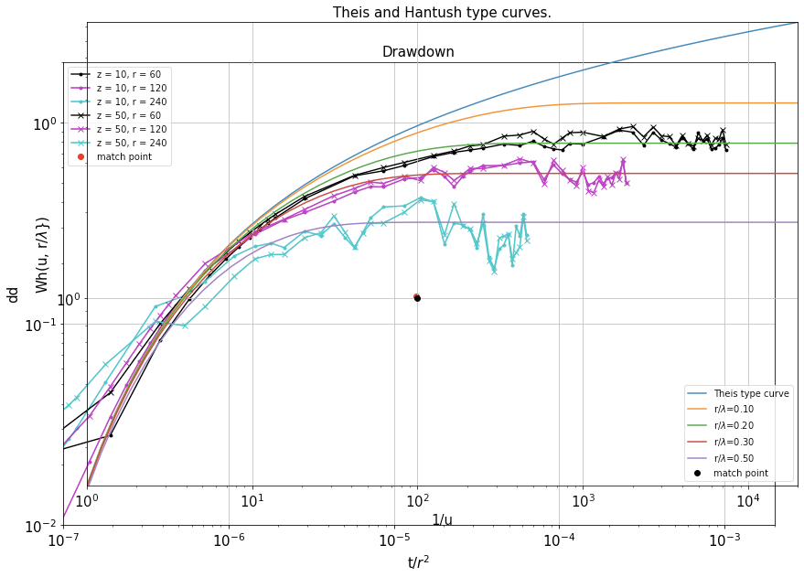

Slide 47
Improving the results
The previous results seem not very accurate. Due to the noise in the data the best fit is not easy to find. So can we do better?
Piezometers at short distance from the well dit show a long straight portion of the drawdown. This can be used like in the Theis situation to determine the transmissivity kD. This can be done irrespective of partial penetration, always works, even when we only mesure inside the well, and is quite accurate.
So from the straight portion of the red line of the chart with the drawdonw of half-log axes we determine the drawdown per log-cycle, which yield an accurate value for the transmissivity kD.
With kD known, we know the vertical shift of both the measurements and the type curves. Therefore, we only have to shift the two charts horizontally to find the best fit. This is done computationally by drawdown a number of Theis type curves for different values of storage coefficient S to find the best fitting one.
The best fitting Theis curve is the dashed red line, for storage coefficient S=0.008.
With the transmissivity and storage coefficient known, we can plot the Hantush type curves over the measurements on the right location.
Finally read the best type curve for each piezometer and note its value of r/𝜆. Like it was done before, each piezometer with given r now yields a value for 𝜆 pertaining to the best fitting type curve. In this case these values for 𝜆 are consistent with each other. We can, therefore, be confident that we have obtained a proper value for the resistance c of the aquitard.
Notes:
𝜆

Slide 48
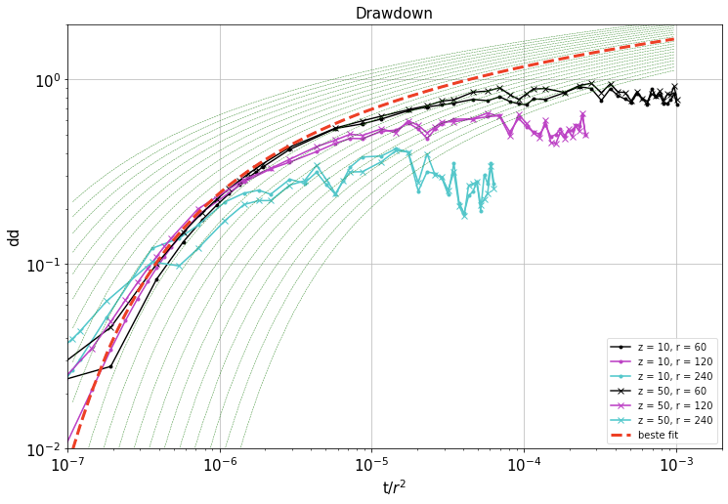

Slide 49
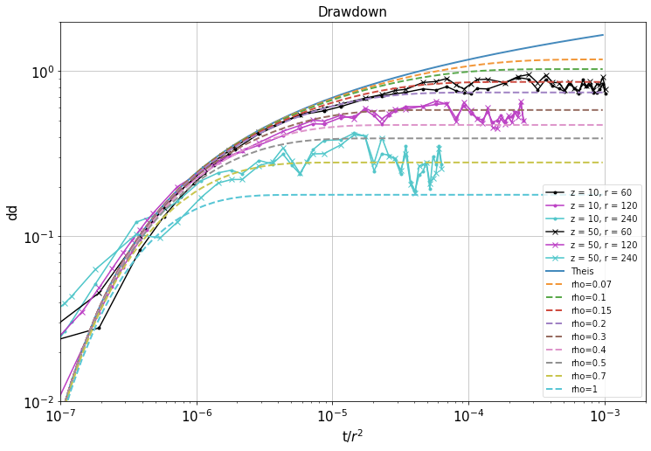

Slide 50
Improving the results
Plotting the type curves over the data to find the best fitting one was was done on a previous chart (thin dashed green lines) is done by plotting
For given kD and the range t/r² of the horizontal axis of the chart and this
for a range of possible values for the storage coeffiient S. Which yields the
green dashed lines. Finally with both kD and S known, we plot the Hantush
curves for a number of values for r/𝜆:

Slide 51
Partial penetration (of the aquifer by the well screen)
Gives an extra drawdown 𝛥s caused by (de)concentration of streamlines near the well
Depening on the location (r, z), 𝛥s an be positive (concentration of steramlines) or negative (deconcenrration of streamlines)
Beyond r>15 D, partial penetration is negligible
Formula next page assumes
The effect of partial penetration is steady (requires t is sufficiently large, radius of influence based on the elastic storage coefficient >>D)
The effect of leakage near the well is negligible (requires 𝜆=√(kDc) is sufficiently large (𝜆 >>D)

Slide 52
Questions and exercises
See section 6.5.7 of the syllabus
See old exam bundle

Slide 53
Measuring from above
Measuring from below
Q₀
Q₀
z₁
z₂
z
k
D
d
z₂
r
r
z₁
z

Slide 54
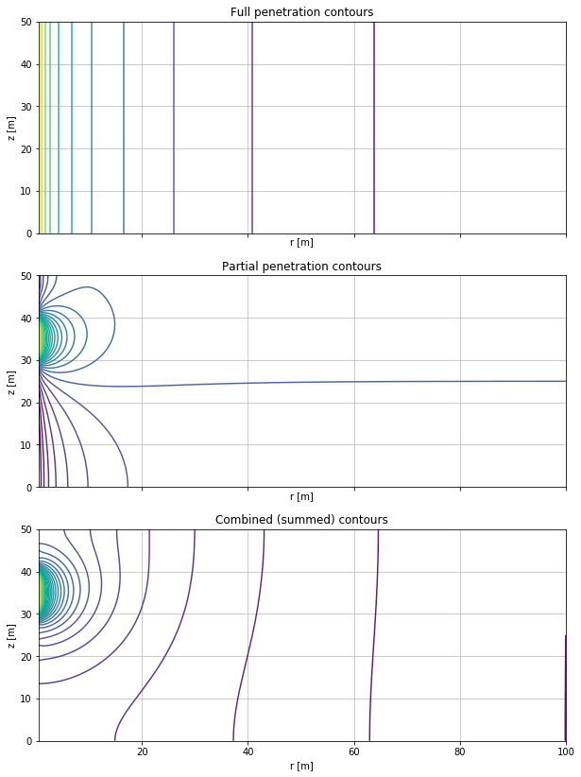
Heads with fully penetrating well
Head deviations due to
partial pentration alone
Superimposed (combined)
Heads fully penetrating screen
plus head devations by partial
Penetrating screen
Ç√

Slide 55
Questions and exercises
See section 6.6.4
See old exams bundle

Slide 56
Not used this time

Slide 57
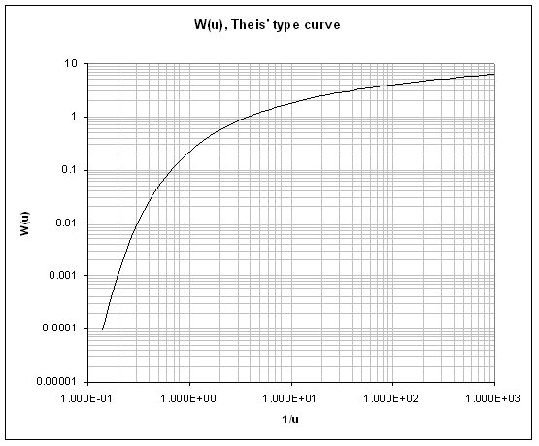
Match point

Slide 58
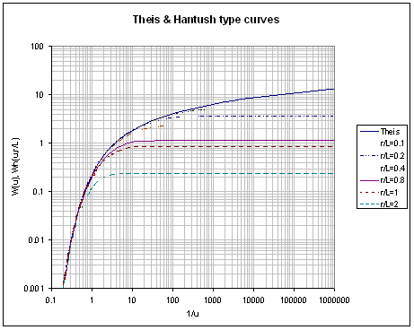
Match point

Slide 59
Match point

Slide 60
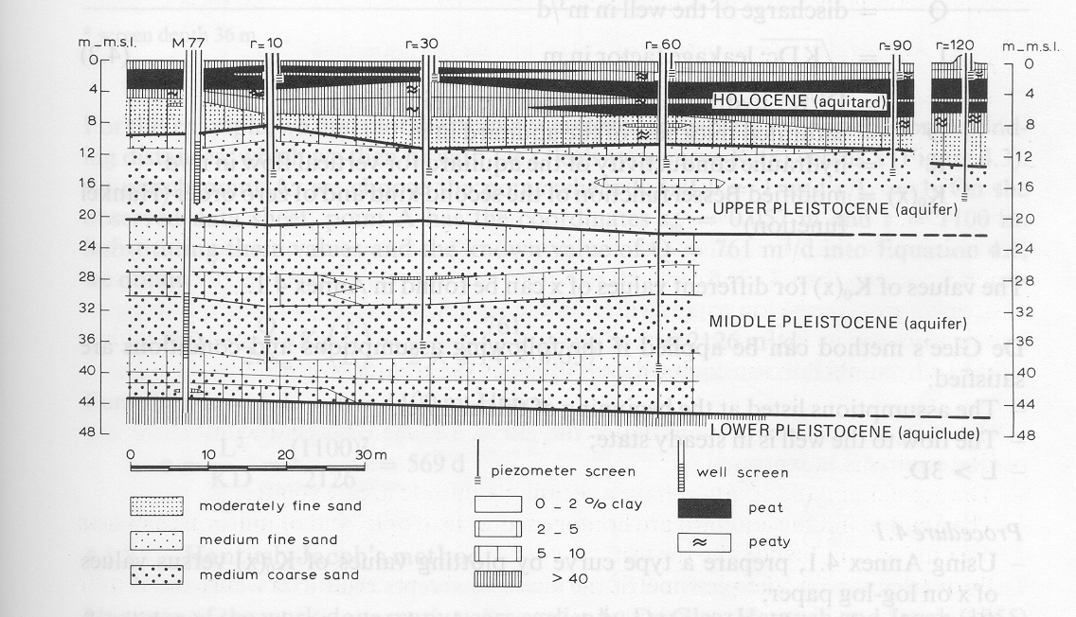

Slide 63
Special wells Well with a large storage (large-diameter well)
r_{c}
k
r_{w}
h
r

